Slide 1

CONCEPTIAL DESIGN PRESENTATION

Slide 2

Mert Kayış

Slide 3
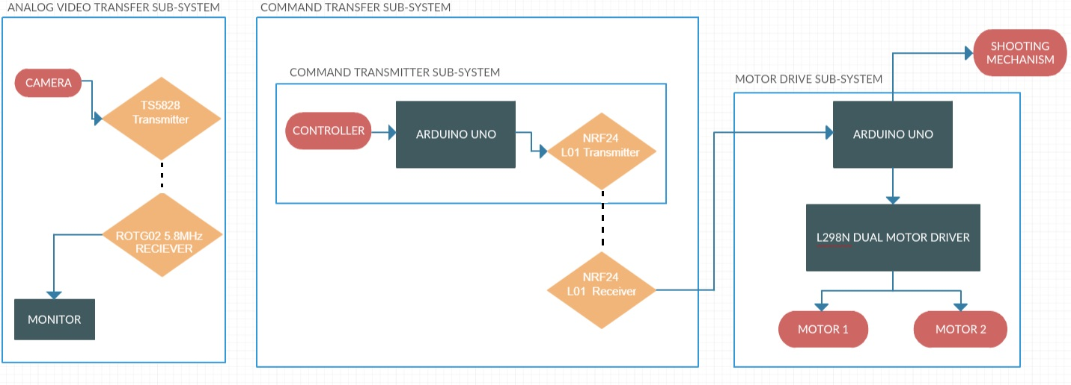
Overall Block Diagram

Slide 4
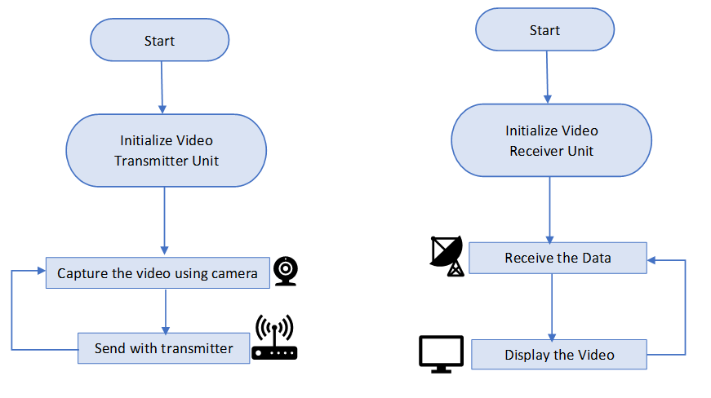
Flowchart for Video Transfer Subsystem
Continuous operation
Continuous operation

Slide 5
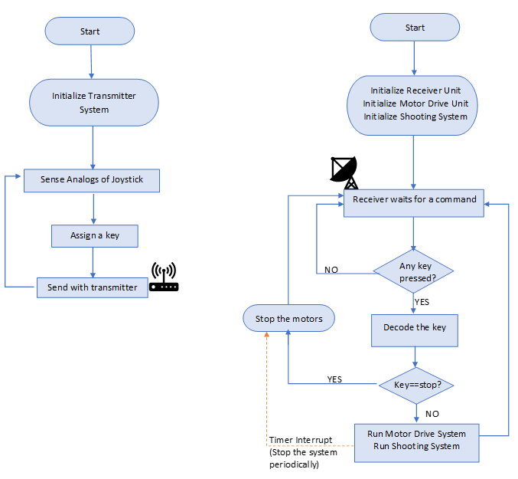
Flowchart for the Command Transfer Subsystem

Slide 6
Flowchart for the Command Transfer Subsystem

Slide 7
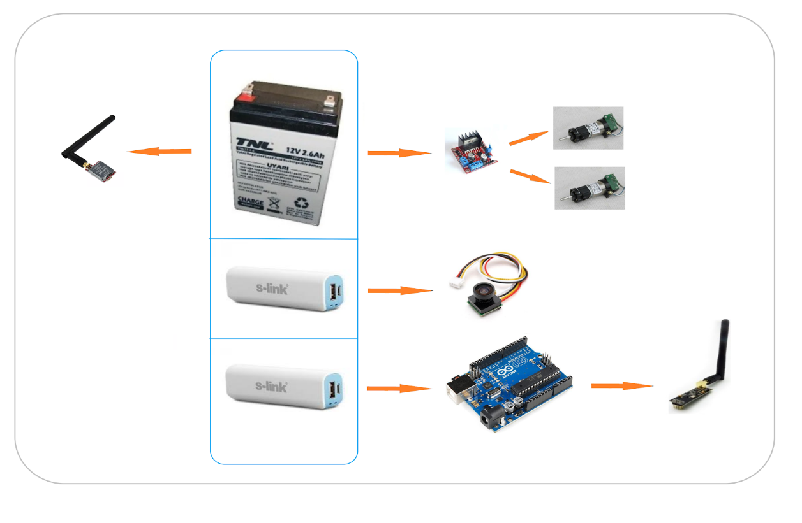
Power Supply Unit

